Slide 1
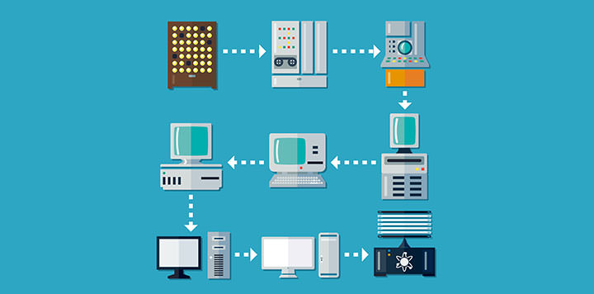
A short history of computers

Slide 2
Outline
Early computing machines – mechanical
First generation – vacuum tubes and valves
Second generation - transistors
Third generation – integrated circuits
Fourth generation – silicon microchips
Fifth generation ?

Slide 3
Early computing machines
About 3000 BC
The abacus was invented, probably in Babylonia

Slide 4
Pascal’s calculator (pascaline)
1642
Blaise Pascal built the first numerical calculating machine that could add and subtract.
Never introduced to the market

Slide 5
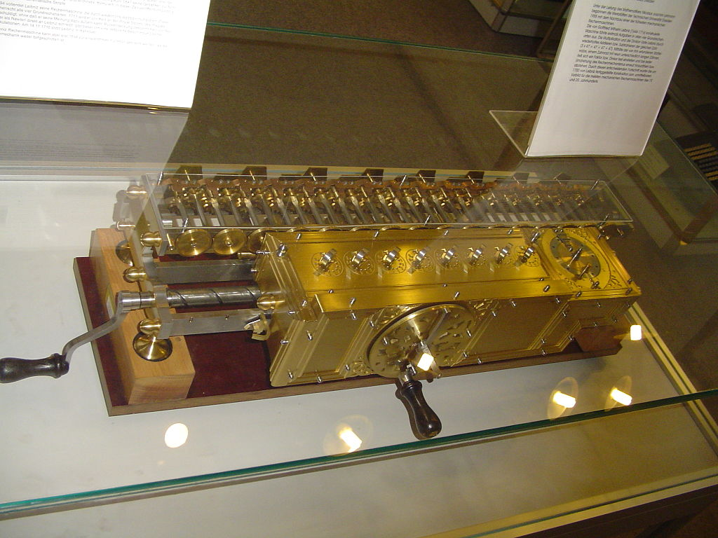
Leibnitz’s step reckoner
1672
Gottfried Leibnitz built a machine that could add, subtract, multiply and divide automatically
He actually started selling it

Slide 6
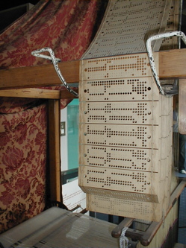
Punched cards
1805
Josef-Marie Jacquard invents perforated card for use on his loom

Slide 7
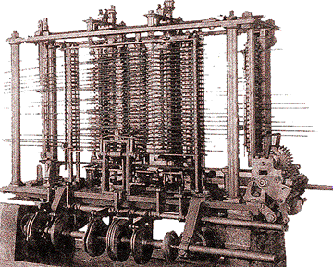
Analytical machine
1833
Charles Babbage designed the analytical machine that followed instructions from punched cards
His ”programmer” was Ada Lovelace (Lord Byron’s daughter)
Steampunk

Slide 8
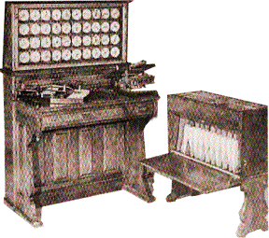
Electro-mechanical machine
1890
Hermann Hollerith actually built an electromechanical machine using perforated cards

Slide 9
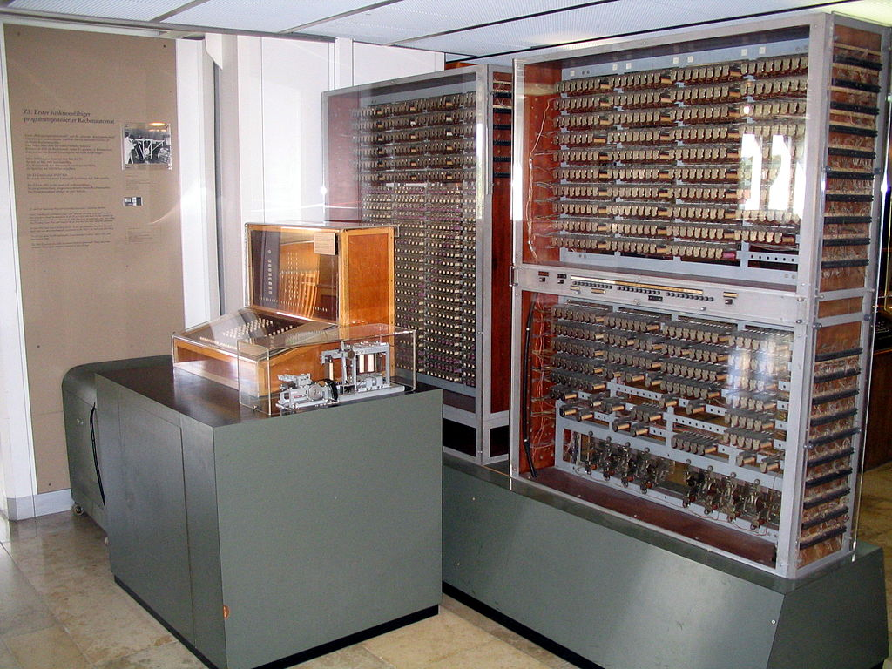
First generation (1941-1956)
Electronic – 1941
Konrad Zuse built the Z3 computer, the first calculating machine with automatic control of its operations
Programmable

Slide 10
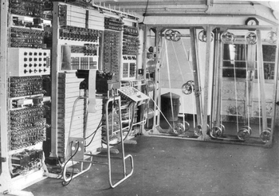
First generation (1941-1956)
Electronic – 1943
Colossus, a British computer used for code-breaking
Enigma machine
Alan Turing and the Bletchley Park’s Government Code and Cypher School (GC&CS)

Slide 11
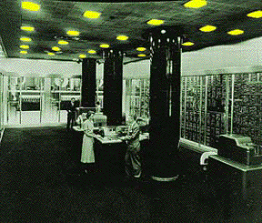
First generation (1941-1956)
Electronic – 1944
Mark I (first relay-based computer for the U.S. Navy)

Slide 12
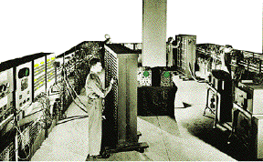
First generation (1941-1956)
Electronic - 1946
ENIAC first ”general purpose” computer
Had 18000 vacuum tubes and weighed 80 tons
Could do 5000 additions and 360 multiplications per second
Electronic Numerical Integrator and Computer = ENIAC

Slide 13
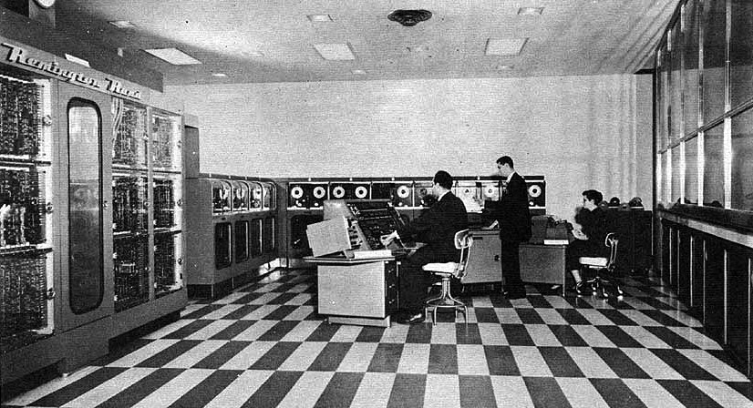
First generation (1941-1956)
Electronic - 1951
UNIVAC used a magnetic tape unit as a buffer memory (temporary external memory)
First commercial computer
UNIVersal Automatic Computer

Slide 14
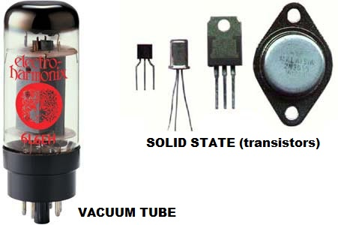
Second generation (1956-1963)
1947
Invention of transistor
Replaced vacuum tubes
Computers became smaller, faster, more reliable, more energy-efficient

Slide 15
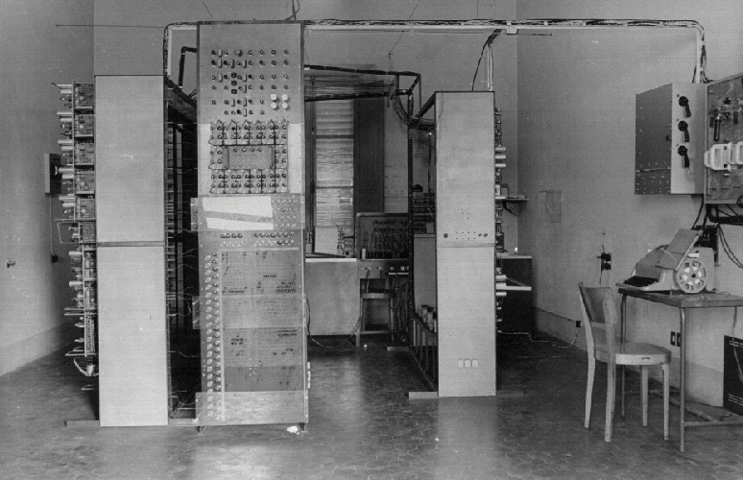
Macchina ridotta and CEP
1957 – Macchina Ridotta
First Italian Computer
1961 – Calcolatrice Elettronica Pisana
Both built at the University of Pisa
http://www.cep.cnr.it/storia07.html

Slide 16
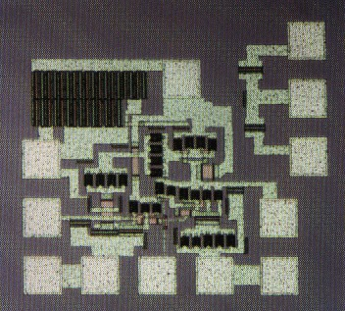
Third generation (1964-1971)
1956
Invention of integrated circuit
Several transistors built into one physical component

Slide 17
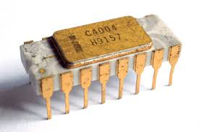
Fourth generation (1971-present)
1971
Intel publicly introduced the world's first single-chip microprocessor (Intel 4004)
All components (i.e. central processing unit, memory, input and output controls) on one small chip.
Programming intelligence into inanimate objects had now become possible.

Slide 18
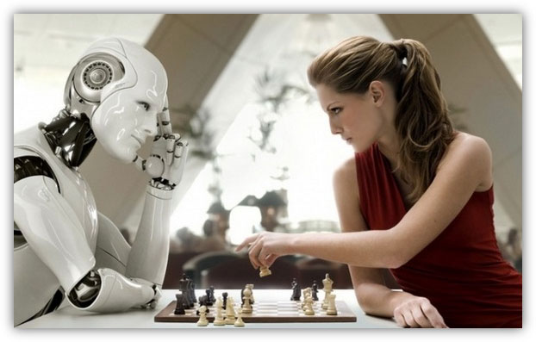
Fifth generation (future?)
Japanese project (1982)
Thousands microprocessors working in parallel as one
Advanced superconductors technology may lead towards no resistance in the electric flow
Based on artificial intelligence (self-learning computers)
Ahead of its time?

Slide 19
Summary
Early computing machines – mechanical
First generation – vacuum tubes and valves
Second generation - transistors
Third generation – integrated circuits
Fourth generation – silicon microchips
Fifth generation - AI?

