Slide 1
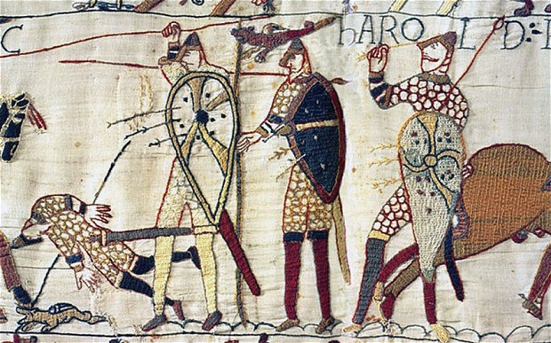
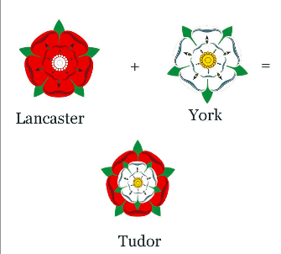
Late Medieval Britain
From 1066 to 1485

Slide 2
Outline
History
William I
the Feudal system
The Plantagenets
Magna Charta Libertatum
Common Law and first Parliament
The Hundred Years’ War
The War of the Roses

Slide 3
William I (c. 1028 – 1087)
Confiscated all the land from the Saxons
Distributed it to his supporting barons
Structured the British society according to the principles of feudalism*
* From the Gothic faihu (late Latin feudum, English fief), i.e. heritable property (in Gothic also cattle) or right granted by a lord to a vassal who held it in fealty (or "in fee") in return for a form of allegiance and service.

Slide 4
The Feudal World

Slide 5
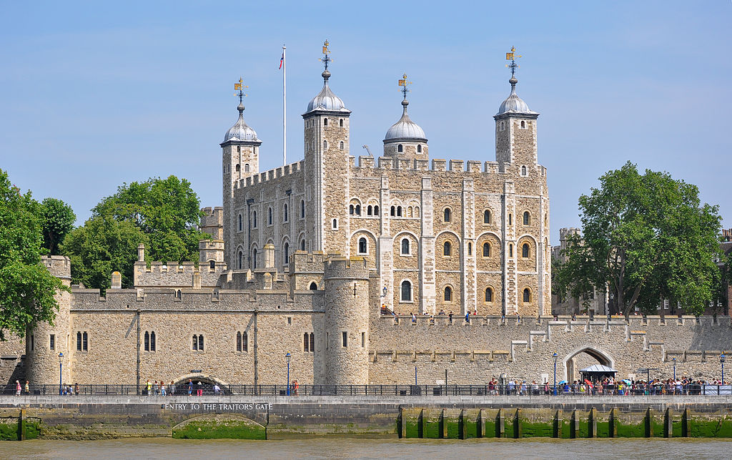
The Feudal World – The Manor

Slide 6
William I
Answer the following questions
Who was William I? By what other names was he called? Why?
What system did William introduce into England? Why?
What is the structure of that system?

Slide 7
The Plantagenets
After William:
William II and Henry I (his children)
Stephen (Henry’s nephew)
Matilda (Henry’s daughter) – civil war between Stephen and Matilda (the anarchy)
Henry II (Matilda’s son): Count of Anjou, Count of Maine, Duke of Normandy, Duke of Aquitaine, Duke of Gascony, Count of Nantes, Lord of Ireland
Anjou > Angevins
Anjou < Original land of Plantagenets (general term that included Angevins, and the Houses of Lancaster and York)

Slide 8
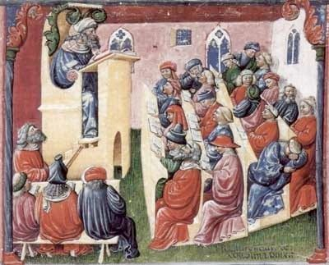
The Plantagenets
Henry II (1154)
Reform of the Judicial System (Common Law)
Assize of Clarendon (1166, first «periodical» court)

Slide 9
The Plantagenets
Henry II
Thomas Becket
King
State
Constitution of Clarendon, 1164
Clerks should be judged by a state court
Archbishop of Canterbury
Church
Clerks should be judged by a religious court
Murdered in the Cathedral

Slide 10
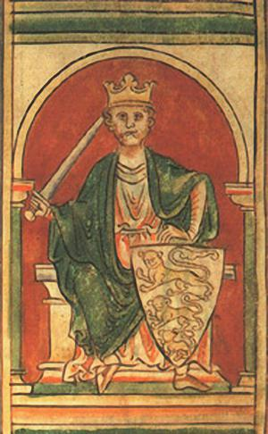
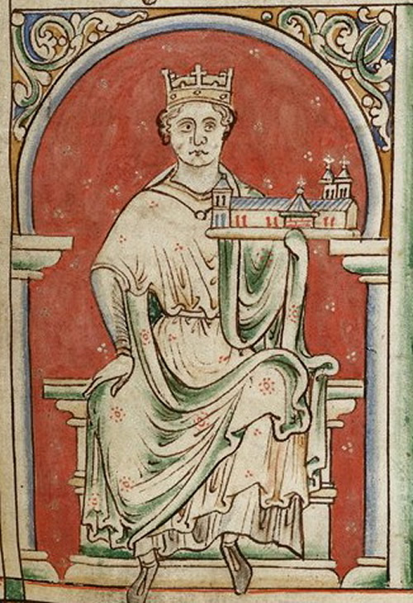
The Plantagenets
Richard the Lionheart
John Lackland

Slide 11
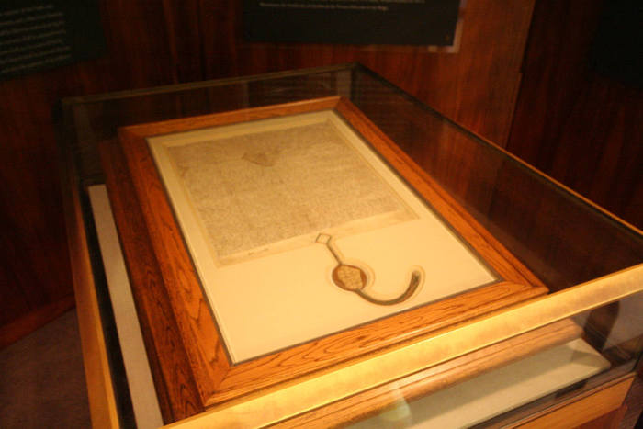
The Plantagenets
King John (1199 – 1216)

Slide 12
The Plantagenets
Magna Charta Libertatum
Originally issued in 1215 (forced by 25 “rebel” barons)
Promised
protection of church rights
protection from illegal imprisonment
access to swift justice, and
limitations on taxation and other feudal payments.
If the king did not conform within 40 days of being notified of a transgression by the Council, the 25 barons could seize John's castles and lands until, in their judgement, amends had been made.

Slide 13
The Plantagenets
Magna Charta Libertatum
Considered the «end» of Feudalism
The nobles acted as a class (not as vassals)
1258 (reign of Henry III, 1216-72): first «parliament» (council led by Simon de Montfort)
from the French «parlement», a meeting to discuss

Slide 14
The Plantagenets (1)
Answer the following questions
What did Henry II do and what happened with Thomas Beckett?
Who signed Magna Charta and why?
Why is Magna Charta so important in European history?

Slide 15
The Plantagenets
Edward I (1272-1307): «Model Parliament» (1295)
Actually, a way to «raise money»
Two main classes that controlled wealth
The «gentry» from the shires
The «merchants» from the buroughs or towns
House of Commons (no taxation without representation)
Representatives: Knights (from shires), burgesses and citizens (from towns and cities), and clergy

Slide 16
The Plantagenets
Edward III (1327-77)
Justices of the Peace
chosen from the landed gentry (neither nobles nor peasants)
made the middle class stronger
The Hundred Years’ War (1337-1453)
against France
The Black Death (1348): 1/3 population died
1455-1485: House of Lancaster vs House of York

Slide 17
The Plantagenets (2)
Answer the following questions
Who created the «Model Parliament» and why?
What were the rising social classes in the 14th century in England?
How did the Parliament evolve in the 14th century?
What were the main causes of the Hundred Years’ War?
How did the War of the Roses end?

Slide 18
Summary
History
William I
the Feudal system
The Plantagenets
Magna Charta Libertatum
Common Law and first Parliament
The Hundred Years’ War
The War of the Roses

