Slide 1
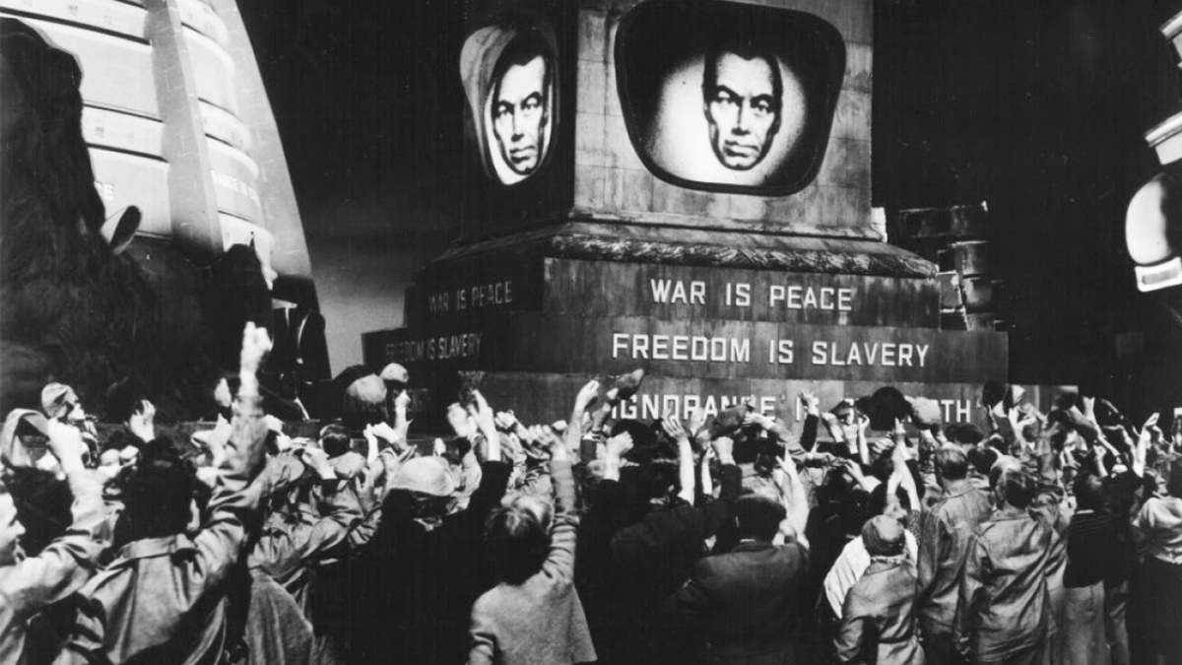
Dystopia

Slide 2
Utopia vs Dystopia
Utopia
dystopia
From Thomas More’s Utopia (1516)
A place or state where a hypothetically perfect society has been created.
A Utopia gone badly wrong
An imaginary place or state where everything is as bad as it could possibly be.

Slide 3
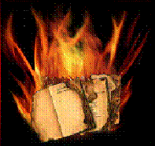
Dystopian Novels
Usually include elements of contemporary society and are seen as a warning against some modern trend.
Used by writers as “cautionary tales”, in which humankind lives in a society that is actually a nightmare.

Slide 4
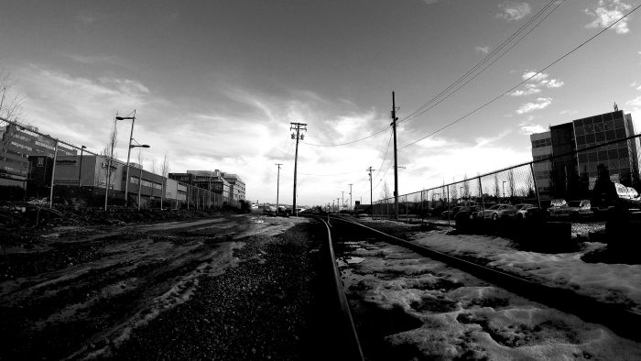
Examples of Dystopian Novels
H. G. Wells, The Time Machine (1895)
A. Huxley, Brave New World (1932)
G. Orwell, Animal Farm (1945) e 1984 (1948)
R. Bradbury, Fahrenheit 451 (1953)
C. McCarthy, The Road (2006)

Slide 5
Brave New World
by Aldous Huxley (1932)
  At first, the world described looks like a utopia: humanity is carefree, healthy, and technologically advanced.
  Warfare and poverty have been eliminated, and everyone is permanently happy.
  However, all of these things have been achieved by eliminating family, cultural diversity, art, literature, science, religion, and philosophy.

Slide 6
Relation to the Real World
Issues of Huxley’s time.
  The Industrial Revolution had brought massive changes to the world.
  Mass production made cars, telephones, and radios cheap and widely available.
  The effects of World War I and totalitarian regimes were still being felt.
Huxley used his book to express the fear of losing individual identity in the fast-paced world of the future.

Slide 7
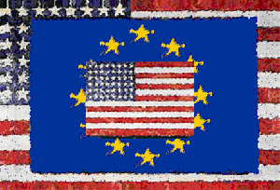
Relation to the Real World
One event that influenced Huxley was an early trip to America.
  Huxley was outraged by the commercial-led cheeriness and selfish nature of many of the people.
  There was a strong fear in Europe of worldwide Americanization.

Slide 8
Relation to the Real World
In Brave New World, Huxley explores the fears of both Soviet communism and American capitalism.
Worse, he suggests that the price of universal happiness will be the sacrifice of everything important in our culture: motherhood, home, family, community, and love.

Slide 9
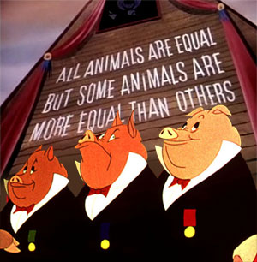
Animal Farm
by George Orwell (1945)
  The story of a revolution gone sour.
  Setting: Manor Farm where the animals revolt against humans in the person of Mr Jones, their farmer.
  First commandment: “All animals are equal”
  End of the story: “All animals are equal but some animals are more equal than others”.
  https://www.youtube.com/watch?v=b4egC00K7Dg

Slide 10
Relation to the Real World
According to Orwell, the fable reflected the events that led up to the Russian Revolution of 1917 and then on into the Stalinist era.
Orwell, a democratic socialist, after his experiences during the Spanish Civil War, became critic of Joseph Stalin.
In a letter, Orwell described Animal Farm as “a satirical tale against Stalin” and most characters are allegories of historical characters.

Slide 11
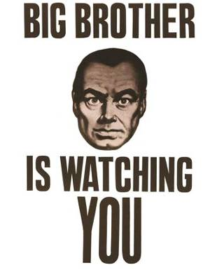
1984
by George Orwell (1948-49)
  Setting: the future world of 1984, where the head of government is the all-knowing Big Brother.
  Hero (Winston Smith): longing for truth and decency leads him to secretly rebel against the government.
  “Thought Police”: Arrest Winston, torture him to “reeducate him” and force him to “love” Big Brother.

Slide 12
Relation to the Real World
Cautionary tale against totalitarianism
Direct parallels between the book and the society of the time:
  Leader worship – similar to Big Brother, dictators Joseph Stalin and Adolf Hitler were revered and followed absolutely
  Joycamps - a reference to Jewish concentration camps
  Thought police – a reference to the Gestapo, the secret police of the Nazis
  The Use of Propaganda – similar tactics were used in the totalitarian regimes of Hitler and Stalin

Slide 13
1984 vs Brave New World
In 1984 people are controlled by constant government surveillance, secret police, and torture.
In Brave New World humans are controlled by scientific and technological interventions that start before birth and last until death, and actually change how people live and what they want.

Slide 14
Fahrenheit 451
by Ray Bradbury (1953)
  Takes place in the twenty-first century, in an America where books are banned.
  Society feels that “opinion” books contain conflicting theories which are disruptive to society and create inequality.
  The penalty for owning one is having one's house and books burnt by "firemen."
  451° F is stated as “the temperature at which book paper catches fire and burns…” (according to Bradbury, of course ;-)).

Slide 15
Relation to the Real World
Bradbury combined several issues of his contemporary society:
  The burnings of books in Nazi Germany.
  Stalin's suppression of authors and books in the Soviet Union.
  The explosion of a nuclear weapon.
  The phenomenon of McCarthyism in early 1950s US.
In Bradbury’s words: "I meant all kinds of tyrannies anywhere in the world at any time, right, left, or middle"

Slide 16
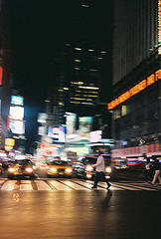
Relation to the Real World
The presence of fast cars, omnipresent television, and advertisements creates a lifestyle with too much stimulation where no one has the time to concentrate.
Bradbury also addressed concerns about censorship at the expense of personal expression.

Slide 17
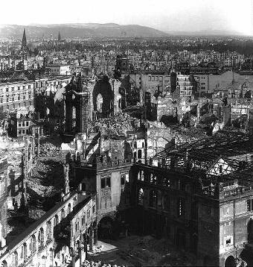
Summary
Dystopian literature reflects the many concerns that resonated throughout the society of the time.
The concept of a dystopia was introduced to help reveal the potential consequences of a utopia turning against itself.

